Slide 1


K.RAMAKRISHNAN COLLEGE OF TECHNOLOGY
(AUTONOMOUS), TRICHY.
DEPARTMENT OF
COMPUTER SCIENCE AND ENGINEERING
20CS5501 DESIGN PROJECT-1
Batch No. : 9
Date : 07.12.2024

Slide 2
Emotion Detection From Text
Guided by Team
Mr. D.P.Devan , Shanmuga Shree M (811722104142)
Assistant Professor,CSE Shruthika K(811722104148)
Sree Aarthi K(811722104151)
Yalini Amirtha K (811721104188)

Slide 3
OBJECTIVE OF THE PROJECT
Build a machine learning or deep learning model capable of classifying emotions from text data.
Train the emotion detection model on the preprocessed data.
Analyze customer reviews and feedback to extract emotional insights, aiding businesses in understanding consumer sentiment and improving their offerings.
Automate the process of emotion detection in large volumes of text data, saving time and resources in fields such as market research and public relations.
Deploy the model as an API or web service that can be accessed by other applications.

Slide 4
ABSTRACT
This project develops an Emotion Detection Model that takes sentence-level emotion into account.
Our technique employs direct emotional keywords in text as a means of identifying emotions.
In order to increase the accuracy of the detection, words and phrases containing emotion-affect were also considered.
We have thought about emotions like happiness, sadness, anger, and so on to help us recognise emotion in text.
It helps facilitate interpersonal communication.

Slide 5
LITERATURE SURVEY
TITLE OF THE PAPER | AUTHOR (S) | PUBLISHER | PAPER GIST | TECHNOLOGY USED
Sentiment Analysis and Emotion Detection from Text | K. Ravi, V. Ravi | Springer | This paper explores the application of NLP techniques. | Rule-based sentiment detection mechanisms.
Emotion Recognition Using Deep Learning on Textual Data | X. Li, L. Zhang | Elsevier | This research focuses on emotion recognition using deep learning. | Deep learning models: RNNs with attention mechanisms.
Sentiment Analysis of Text Using NLP Techniques | A. J. Kumar | Springer | This uses natural language processing (NLP) techniques. | Rule-based systems for initial sentiment analysis.
Detecting Emotions from Text with Hybrid Models | M. Patel, P. Roy | IEEE | The paper explores the use of hybrid models. | Hybrid approach lexicon-based.
Emotion Detection from Online Text: Challenges and Opportunities | S. Gupta | Elsevier | This comprehensively reviews the state-of-the-art techniques | Tools with multimodal emotion detection frameworks.

Slide 6
Automatic Emotion Detection for Social Media Text | T. Lee, J. Park | IEEE | The goal of automatic emotion detection in social media text | Sentiment Analysis Tools

Slide 7
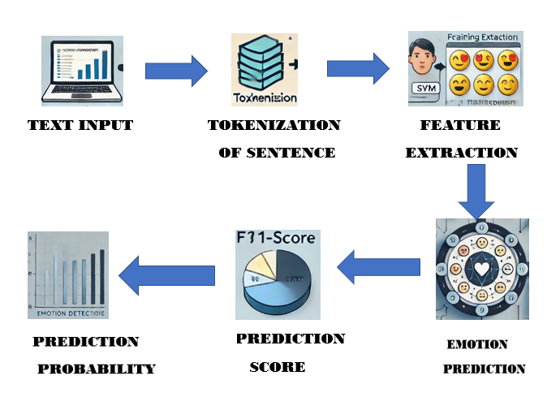
PROPOSED SYSTEM ARCHITECTURE

Slide 8
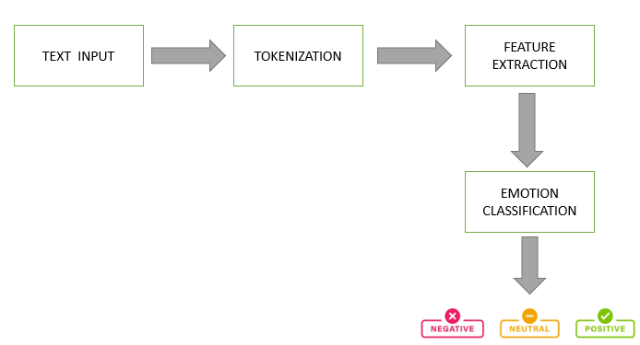
EXISTING SYSTEM ARCHITECTURE

Slide 9
SOFTWARE AND HARDWARE REQUIREMENTS
HARDWARE
SOFTWARE
Processor (CPU):Intel core i5.
Storage
Memory (RAM):16+Gb for Large dataset .
Graphics Processing Unit (GPU):NVIDIA GPU
Python,HTML,CSS.
Libraries : Pandas,numpy
Text Preprocessing Tools:Neat Text.
Dataset: Goemotion.
Machine Learning Platforms:NLTK
Visualization Tools : seaborn

Slide 10
MODULES
Text Input Module
Preprocessing Module
Prediction Module
Visualization Module
Communication Module

Slide 11
SUMMARY OF MODULE-1
TextInput Module:
Captures user text through a Streamlit-based interface, allowing for emotion analysis. Ensures inputs are valid and non-empty before sending them for processing. It provides an intuitive starting point for user interaction. Acts as the bridge between the user and the system.

Slide 12
SUMMARY OF MODULE-2
Preprocessing Module:
Cleans and processes raw text by removing noise like punctuation, stopwords, and redundant spaces. Tokenizes the text and applies stemming or lemmatization for consistency. Prepares the text to be in a model-friendly format. Enhances prediction accuracy by focusing on meaningful features.

Slide 13
SUMMARY OF MODULE-3
Prediction Module:
Uses a pre-trained machine learning model to classify the emotion of the processed text. Provides confidence scores for each emotion and maps predictions to intuitive emojis. Outputs accurate and engaging results to the user. Forms the system's analytical core.

Slide 14
SUMMARY OF MODULE-4
Visualization Module:
Displays the predicted emotion and emoji alongside the input text. Visualizes confidence scores for emotions through an Altair-generated bar chart. Updates results dynamically based on user input. Makes the output accessible and visually appealing for all users.

Slide 15
SUMMARY OF MODULE-5
Communication Module:
Manages data flow and synchronization between all modules. Handles input submission, processing, prediction, and result visualization seamlessly. Uses Streamlit tools for smooth, real-time updates without reloading. Ensures the entire system works cohesively.

Slide 16
RESULTS AND DISCUSSION
The performance of the emotion detection model was evaluated using various metrics, including accuracy, precision, recall, and F1-score.
The results show that the model performed well in detecting emotions, with an overall accuracy of 84.2%. The model performed best in detecting neutral emotions, with an accuracy of 90.1%. The model struggled slightly with detecting fear emotions, with an accuracy of 78.5%.
Future studies can build upon this research by exploring the use of more advanced machine learning algorithms, incorporating multimodal data (e.g., text, images, audio), and examining the model's performance in different contexts and cultures.

Slide 17
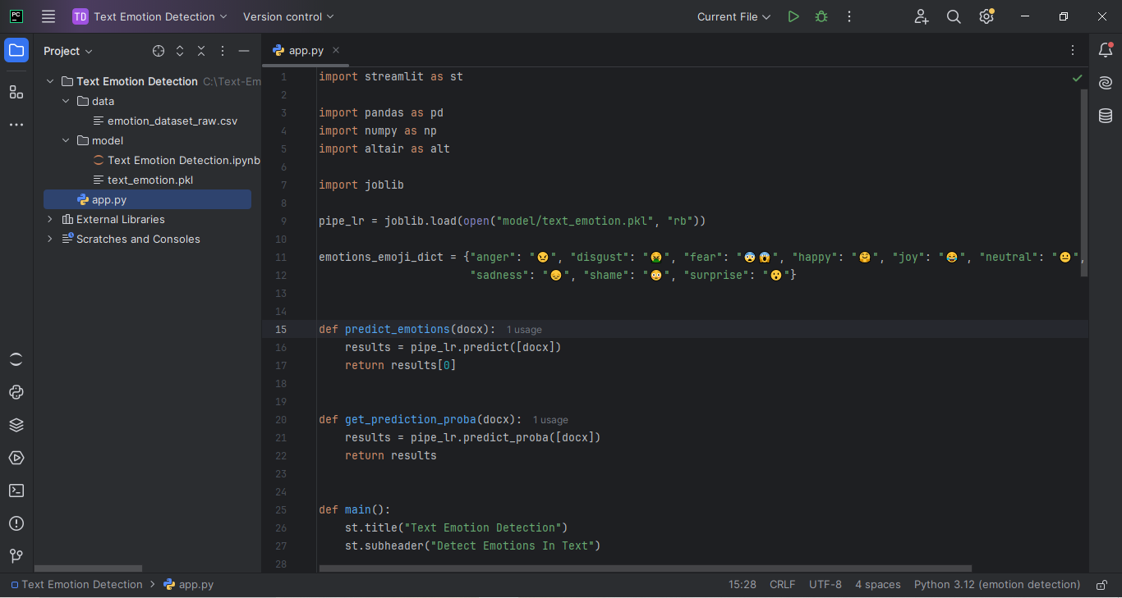

Slide 18
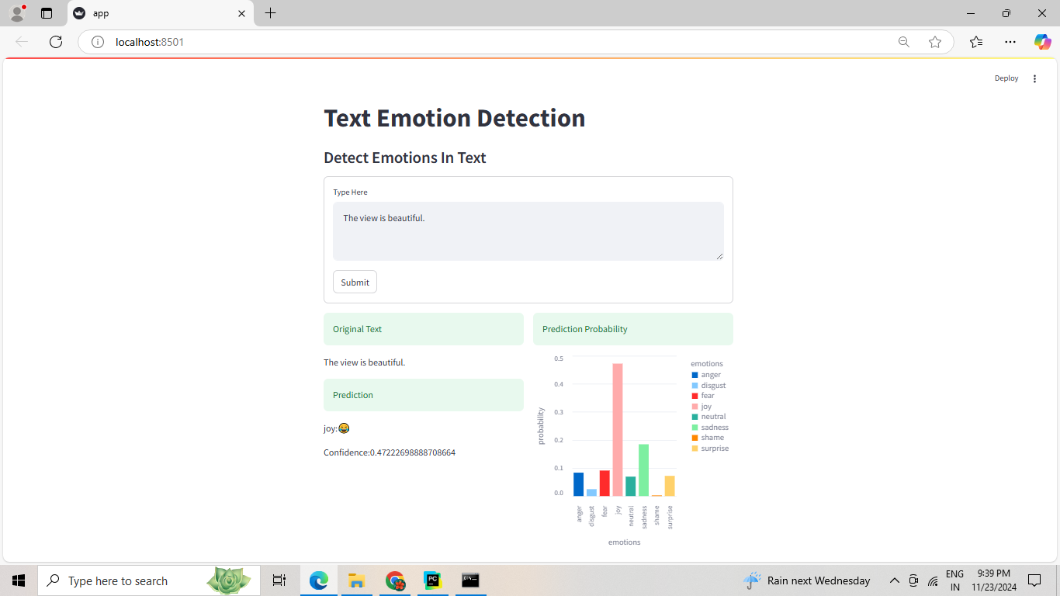

Slide 19
CONCLUSION
Emotion Detection Using Text project successfully demonstrates how machine learning and natural language processing (NLP) techniques can be used to identify and classify human emotions based on textual data .
By experimenting with various machine learning and deep learning models such as Support vector machine, Random forest classifier and Logistic regression we achieved a high level of accuracy in emotion classification.
This project highlights the potential for real-world applications in areas such as customer support, social media analysis, mental health monitoring, and sentiment analysis.

Slide 20
THANK YOU

